Slide 1
Unit 3- Propositional Logic Semantics

Slide 2
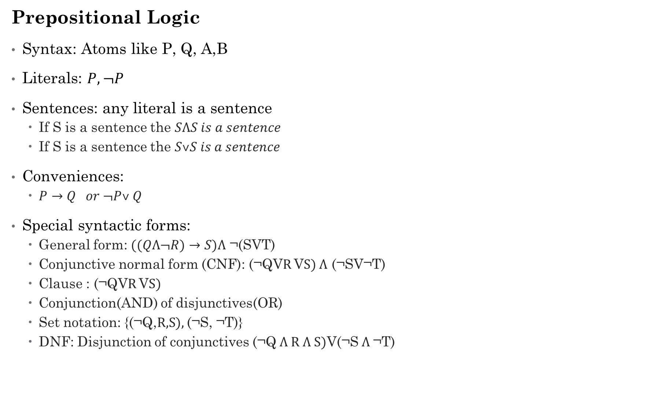
Prepositional Logic
Syntax: Atoms like P, Q, A,B
Literals: $P,¬P$
Sentences: any literal is a sentence
If S is a sentence the $SɅS is a sentence$
If S is a sentence the $S˅S is a sentence$
Conveniences:
$P→Q or ¬P˅ Q$
Special syntactic forms:
General form: $((QɅ¬R)→S)Ʌ$ ¬(SVT)
Conjunctive normal form (CNF): (¬QVR VS) $Ʌ$ (¬SV¬T)
Clause : (¬QVR VS)
Conjunction(AND) of disjunctives(OR)
Set notation: {(¬Q,R,S), (¬S, ¬T)}
DNF: Disjunction of conjunctives (¬Q $Ʌ$R $Ʌ$S)V(¬S $Ʌ$¬T)

Slide 3
Binary clauses: 1 or 2 literals per clause
(¬QVR)
(¬SV¬T)
Horn Clause: 0 or 1 positive literals per clause
(¬QV¬RVS)
(¬SV¬T)
(SVT) : not a horn clause (2 positive literals)

Slide 4
Propositional Logic Semantics
Syntax: which arrangements of symbols are legal
Semantics: what the symbols mean in the world.
Mapping between symbols and worlds.
Defines the truth of each sentence with respect to each possible world
X+Y =4 is true in the world where X=2 and Y=2, and false in the world where X=1 and Y=2
P Ʌ Q the model P= True and Q= True would be consistent with P Ʌ Q

Slide 5

Satisfiability
Sentence S is satisfiable if it is true in some world.
If it is false in all worlds, it is unsatisfiable
$P⟶Q$
R$⟶¬R$
SɅ(wɅ$¬S) is unsatisfiable$
Validity
Sentence S is valid if it is true in all world
TɅ$¬T$
$P⟶P$

Slide 6
Entailment
Sentence S2 follows logically from another sentence S1 we say S1 entails the sentence S2
S1⊨S2
S1⊨S2 if and only if every model in which S1 is True , S2 is also True
In arithmetic X.Y = 0
X=0 entails the sentence X.Y=0
If X=0 is True then X.Y=0 is also True
Soundness
If the inference algorithm derives only entailed sentences, then it is called a Sound algorithm or a truth preserving algorithm
Very highly desirable property of an inference procedure

Slide 7
Completeness
If the inference algorithm can derive any sentence that is entailed, then it is called a Complete algorithm
Very highly desirable property of an inference procedure
If KB is true in real world, any sentence S derived from that KB by a sound and complete inference procedure is also true in the real world.
Completeness is a problem in case of an infinite space; like DFS in an infinite space

Slide 8
WUMPUS world
Based on “Hunt the Wumpus” a computer game
Cave consisting of connected rooms with passages
Inside the cave there is a Wumpus somewhere, it eats anyone who enters the room
Some rooms have Pits which will trap anyone that enters the room
There is gold somewhere in the room and you will have to hunt for it
Agent can shoot the Wumpus and it has only one arrow.
The agent is successful if it comes out of the cave safely with the gold.

Slide 9
PEAS:
Performance measure
1000 points when you come out of the cave with gold
- 1000 point if you are eaten by the Wumpus or fall into a pit
Game ends when the agent comes out of the cave safely or when it dies

Slide 10
Environment:
4X4 Grid of rooms
Starts at square [1,1]
Agent always start at [1,1] facing right
Location of Gold and Wampus can be
Anywhere (random) except the square [1,1]
Wumpus can be dead or Alive
Actuators:
Agent can move Forward
TurnLeft by 90 degree
TurnRight by 90 degree
Agent dies if it enters a square containing
a live Wumpus or a Pit
Grab: grab the gold
Shoot: shoot the arrow
Climb: climb out of the cave (possible only through [1,1])

Slide 11
Sensors:
Total 5 sensors
Stench: square adjacent to one
where the Wumpus is , the
agent will perceive a stench
Breeze: square adjacent to Pit the
agent will perceive breeze
Glitter: square where there is Gold the
agent will perceive Glitter
Bump: when an agent walks into a wall
it perceives Bump
Scream: when the Wumpus is shot the
agent will perceive Scream
Start state : [1,1] [None, None, None, None, None]
[2,1] [None, Breeze, None, None, None]
[1,2] [Stench, None, None, None, None]

Slide 13
Safe squares: no pit and no Wumpus
Safe squares are denoted as OK
[1,2 ] and [2,1] are OK and the agent can move
to either of the squares from [1,1]
When it moves to [2,1] it perceives Breeze (B)
It shows there must be a Pit in the neighboring
Square.
Pit cannot be in [1,1] so there must a Pit in
[2,2] or [3,1], denoted by P
Only one safe possibility go back to [1,1] and go to
[1,2]
An intelligent agent takes this move
In [1,2] agent perceives a Stench , indicating the Wumpus is nearby

Slide 14
Wumpus cannot be in [1,1]
Cannot be [2,2] or else the agent
Must have perceived the Stench when he visited [2,1]
Agent therefore infers that the Wumpus is in [1,3]
Denoted by W!

